Slide 1

Animal recognition
Image-audio recogntion & retrieval for pictures and sounds of animals
DIGITAL SIGNAL & IMAGE PROCESSING
2020-2021
Federico Luzzi - 816753
Federico De Servi - 812166

Slide 2
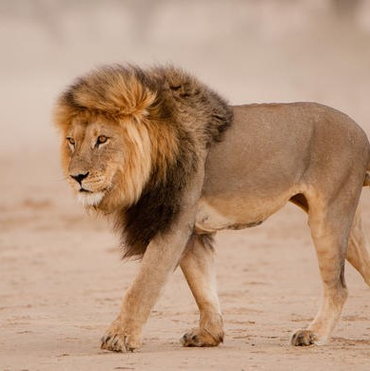
Topics
1) AUDIO RECOGNITION
2) IMAGE RECOGNITION
3) IMAGE RETRIEVAL
4) DEMO

Slide 3
AUDIO RECOGNITION

Slide 4

Objective
The objective is to train a CNN model in order to classify correctly the biggest number of audio containing sounds of animals. These sounds have a lenght that ranges from 2 to 3.5 seconds and different levels of background noise.

Slide 5
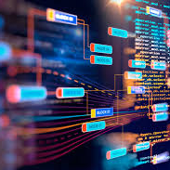
Dataset
The audio dataset has been downloaded from the Animal Sound Archive made available by the Museum für Naturkunde Berlin through the Gbif website. It is composed of audios whose lenght is variable. The audios has been manually cut in order to isolate the sound (3.5 sec max).
Moose
Buffalo
Chimpanzee
Deer
Fox
Horse
Lion
Otter
Racoon
Sheep

Slide 6
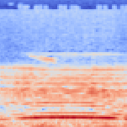
Preprocessing
First of all, the Resnet preprocessing function is applied. Then, after applying data augmentation to the audios (pitch shift, gaussian noise, normalization), a mel-spectrogram is created from each audio. A Frequency Mask is applied to some of the mel-spectrograms. This audio classification problem became then a classical image classification one, thus giving the opportunity to even use pre-trained models like ResNet.

Slide 7
Modelling
ResNet101
Dropout(0.5)
ReLU()
BatchNormalization()
Dense(200, activation='relu', kernel_regularizer=regularizers.l2(l2=0.0005))
Dropout(0.5)
ReLU()
BatchNormalization()
Dense(10, activation='softmax')
Since the problem is umbalanced, we calculated the first thing to do is to calculate the weights for each of the 10 classes, and to use them during training. Various models has been tried, ranging from simple CNN models to complex image recognition models.
After many trials, this model resulted to be the best. It uses ResNet101 with imagenet weights, followed by a block made of Dropout + ReLu activation function + BatchNormalization layer. Then, a Dense layer with 200 units and l2 weight regularization and another block of Dropout + ReLu activation function + BatchNormalization layer follow. In the end, a Dense layer with 10 units and softmax activation function is added as final layer.
+
+
+
+
+
+
+
+

Slide 8
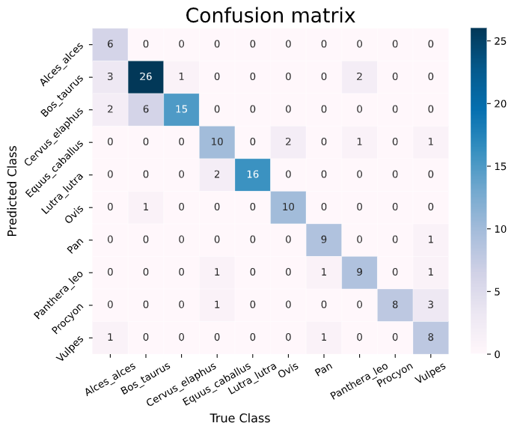
Results

Slide 9
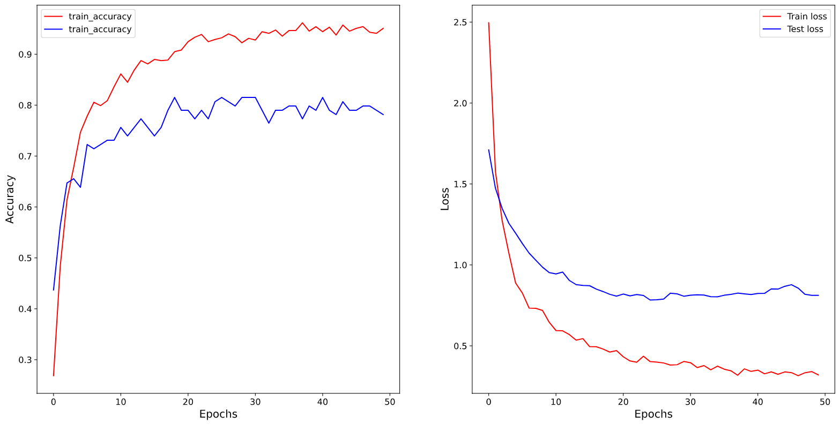
Results

Slide 10
ResNet101
Cut at «conv3_block1_2_relu»
Classical Classifiers
SVM
Logistic Regression
Classifiers
Since the audio dataset is small and very different from the ImageNet dataset, another approach used was to use the ResNet as a feature extractor and then train some classical classifiers (SVM, Logistic Regression) on those features.
This improved the performances obtained on the test set, at the expense of efficiency and execution speed of the predictions.
This also explains why the Demo contains the fine-tuned ResNet and not this approach.

Slide 11
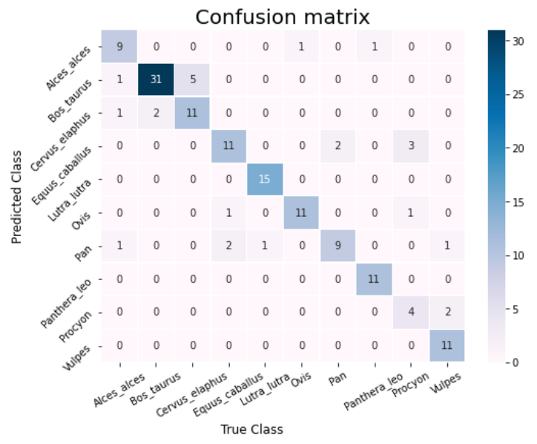
Results (SVM)

Slide 12
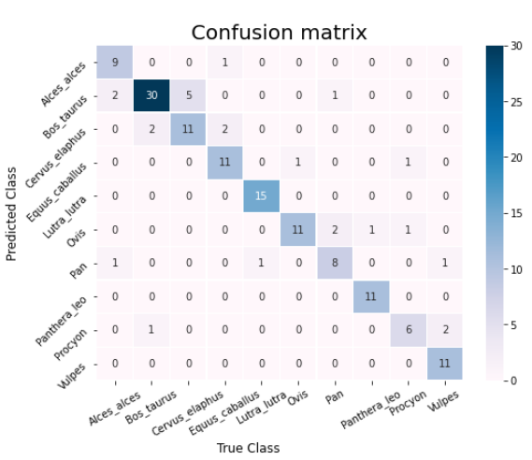
Results (L. Regression)

Slide 13
image RECOGNITION

Slide 14
Objective
This time the objective is to perform a classic image classification problem. After applying some data augmentation techniques to the images (ImagesWithAttributes2 ), transfer learning with different pretrained models has been used.

Slide 15
Dataset
The image dataset has been downloaded from the Animal with Attributes 2 website. It is composed of thousands of pictures of animals of various sizes. The selected classes are:
Moose
Buffalo
Chimpanzee
Deer
Fox
Horse
Lion
Otter
Racoon
Sheep

Slide 16
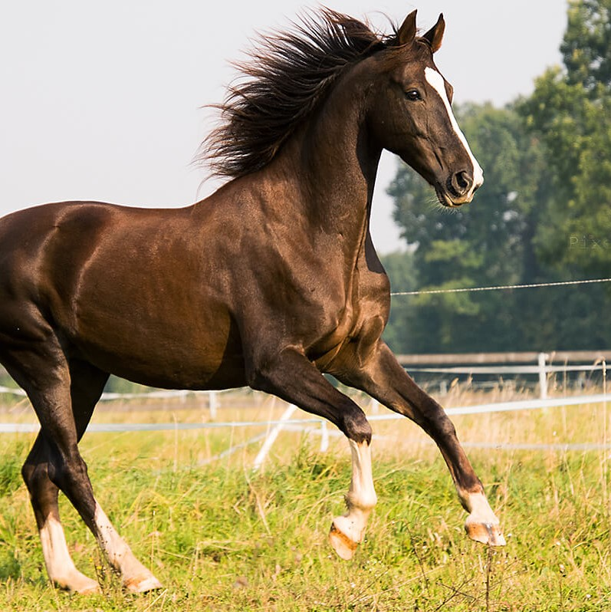
Preprocessing
First of all, the Resnet preprocessing function is applied. After doing that, data augmentation techniques, like zooming, flipping horizontally, rotating, shifting and changing the brightness are applied to the images. Then, the images are imported as 224x224x3 rgb images and fed them to the model.

Slide 17
Modelling
ResNet101
BatchNormalization()
Dense(50, activation='relu', kernel_regularizer=regularizers.l2(l2=0.0005))
BatchNormalization()
Dense(10, activation='softmax')
Since it is still an umbalanced problem, the weights for each of the 10 classes are calculated, and used during training. The obvious choice here was to use transfer learning from previously trained models on imagenet.
After many trials, this model resulted to be the best. It uses ResNet101 with imagenet weights, followed by a BatchNormalization layer. Then, a Dense layer with 50 units and l2 weight regularization and another BatchNormalization layer follow. In the end, a Dense layer with 10 units and softmax activation function is added as final layer.
+
+
+
+

Slide 18
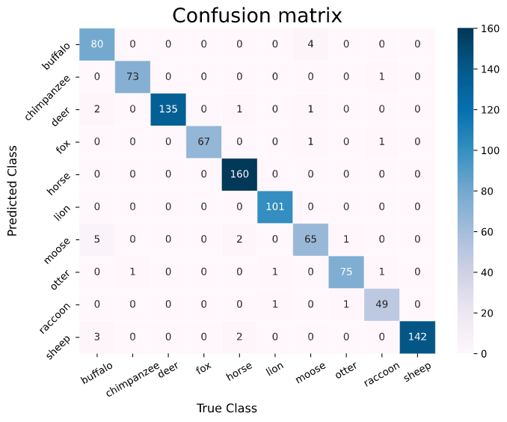
Results

Slide 19
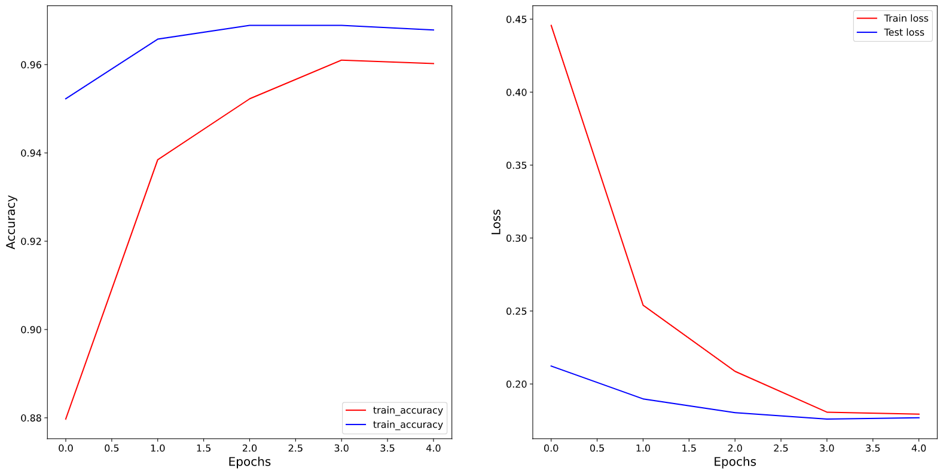
Results

Slide 20
Image retrieval

Slide 21
Objective
The goal of the Image Retrival task is to select the 9 most similar animal images based on a query one. In particular, this tool would perform on real animals images and picture ones.

Slide 22
Dataset
The image dataset is the same as before. It is composed of thousands of pictures of animals of various sizes. The same classes as before are selected:
Some paintings belonging to those 10 classes also selected and downloaded from google image search for testing purposes.
Moose
Buffalo
Chimpanzee
Deer
Fox
Horse
Lion
Otter
Racoon
Sheep

Slide 23
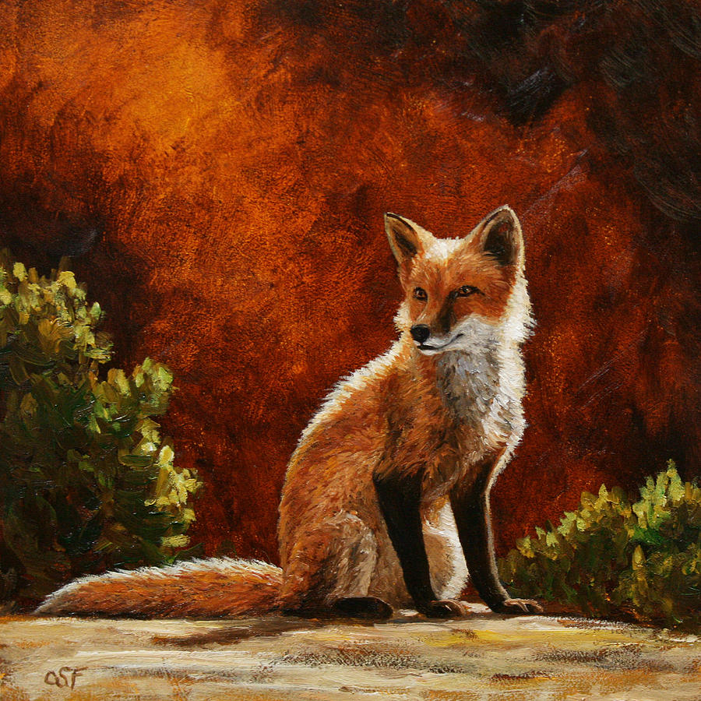
Preprocessing
The neural network wants an input image of 224x224 pixels with 3 color channels (RGB). So the query image would be resized to fit in.
Also resnet preprocess function is applied.

Slide 24
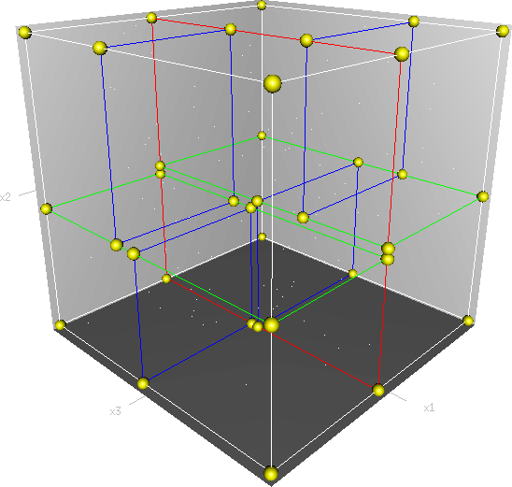
Modelling
ResNet101
Feature Extraction
KDTree
Different popular neural networks have been tried to generate the feature space: mobilenet_v2, inceptionV3, …
The best model tried is ResNet101, the whole model is used except the feedforward part.
Each instance have 2048 features.
In order to get a fast response on the features space a KDTree structure is implemented.

Slide 25
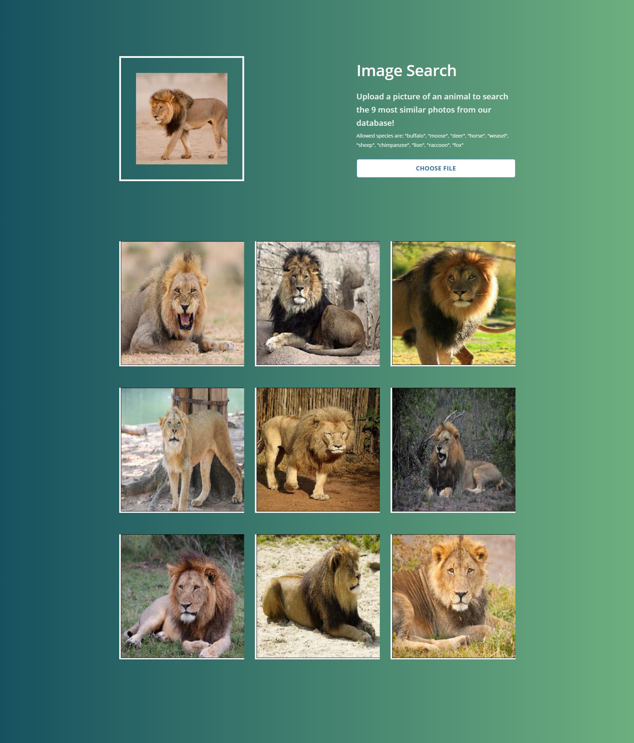
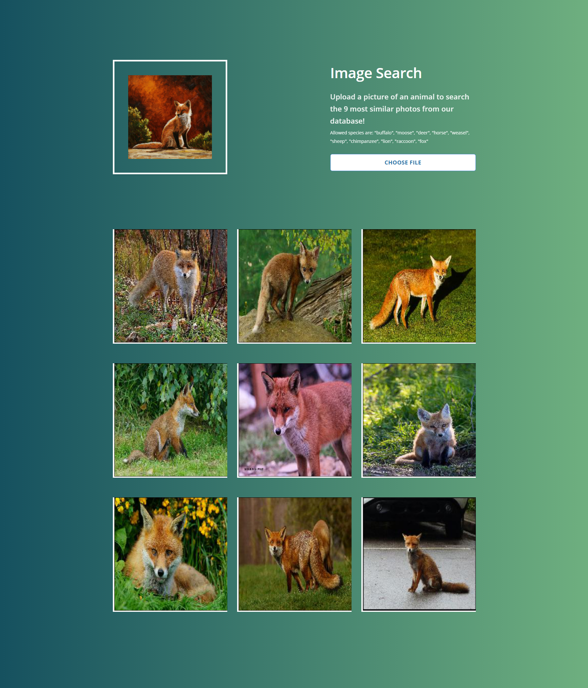
Results

Slide 26
Demo

Slide 27
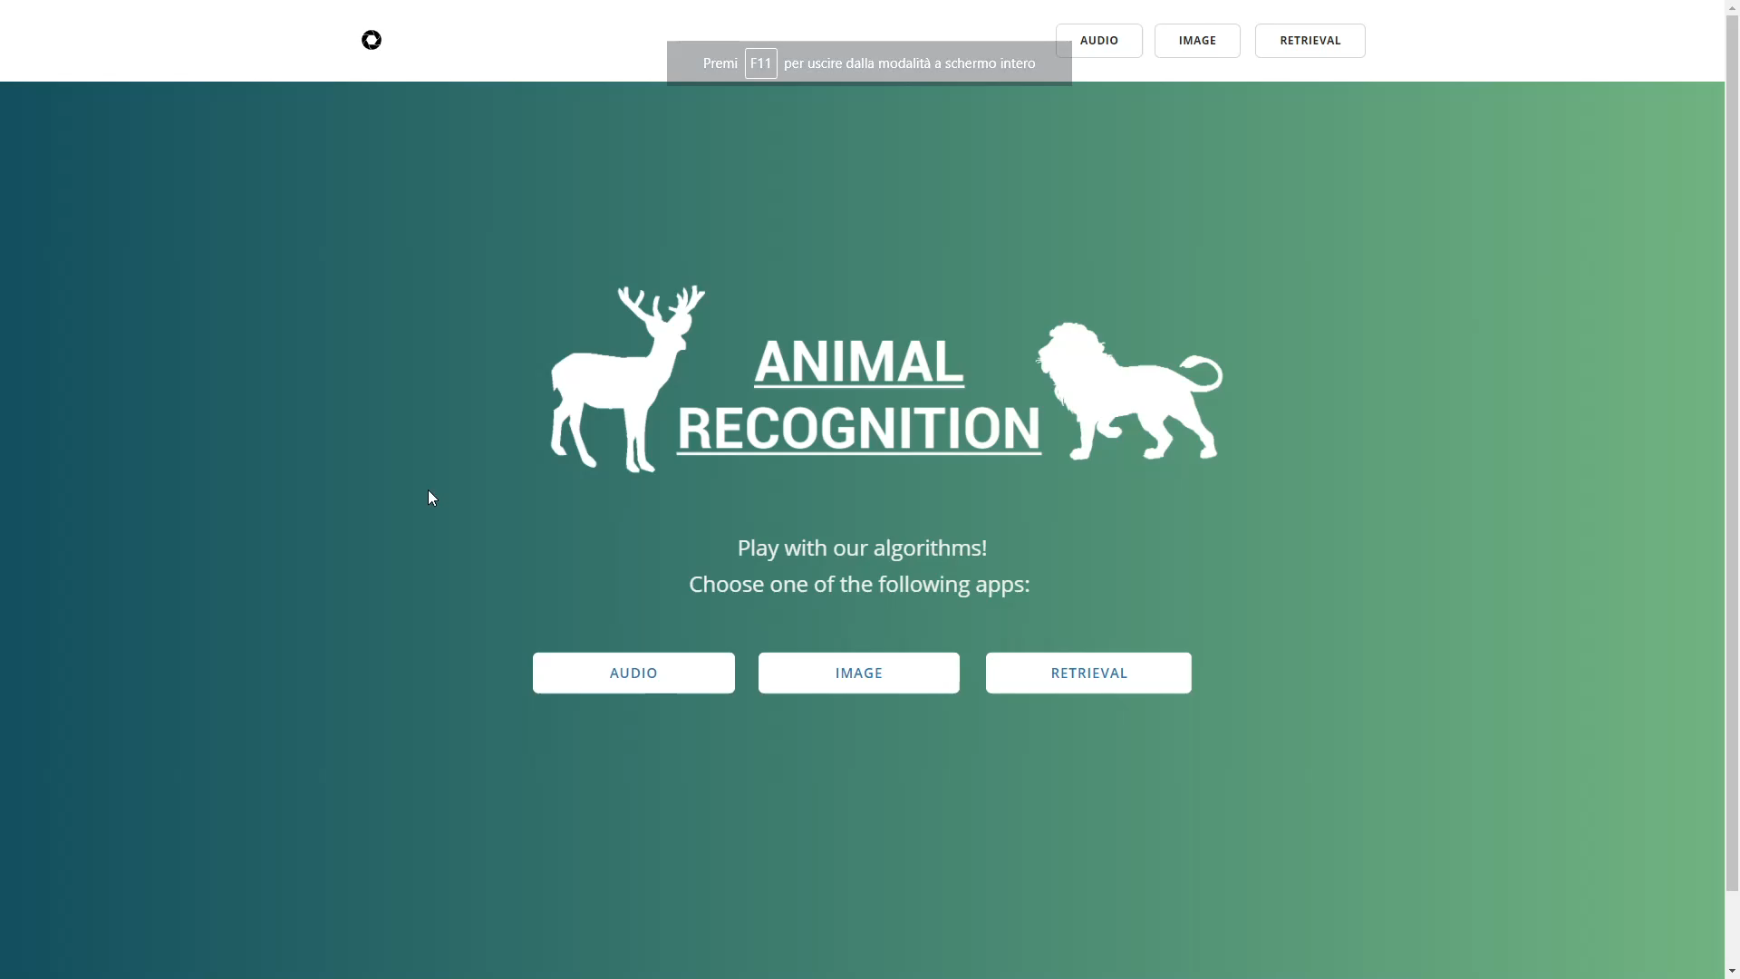
Demo

Slide 28
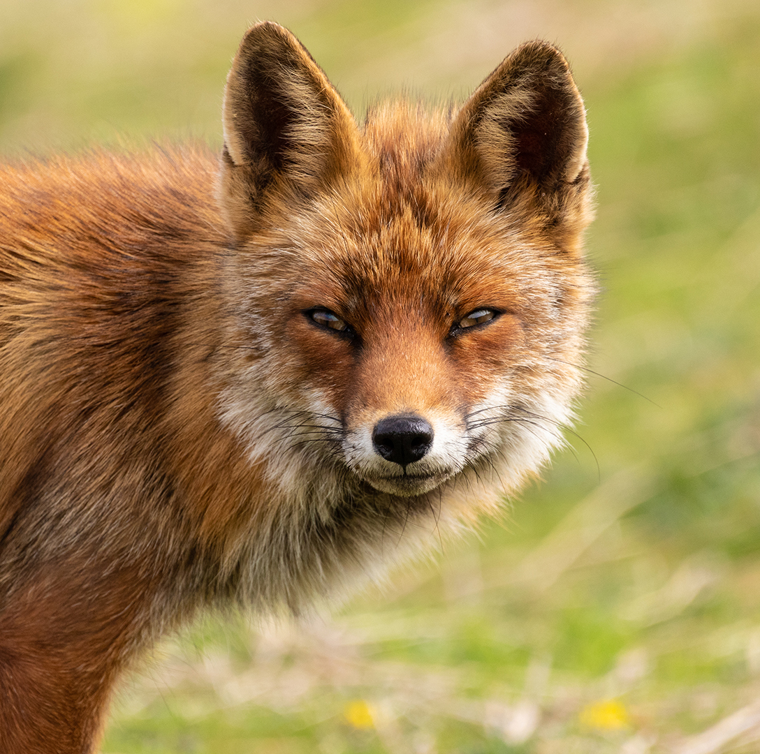
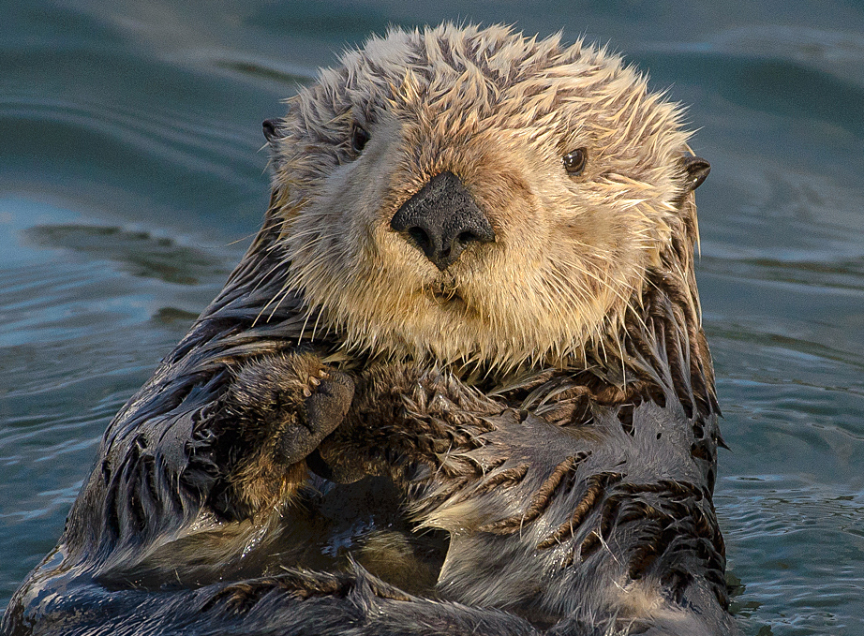
Grazie
Federico Luzzi - 816753
Federico De Servi - 812166

